Slide 1
Welcome
18/09/2019
Cricket World Cup-2019
Prediction
Presented By - Rhugved Takalkar (36058)
Guided By - Prof. Sugandha Nandedkar

Slide 2
CONTENT
Workflow
Dataset information
Feature Engineering
Brief on System
Output

Slide 3
Workflow
Data cleaning and formatting.
Exploratory data analysis.
Feature engineering and selection.
Compare several machine learning models on a performance metrix.
Perform hyperparameter tuning on the best model.
Evaluate the best model on the testing set.
Interpret the model results.

Slide 4
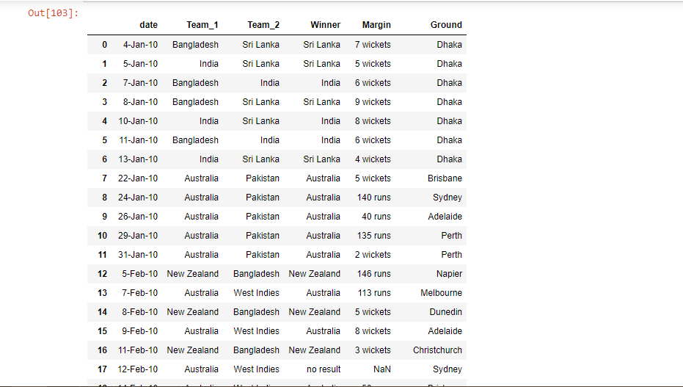
Dataset-1

Slide 5
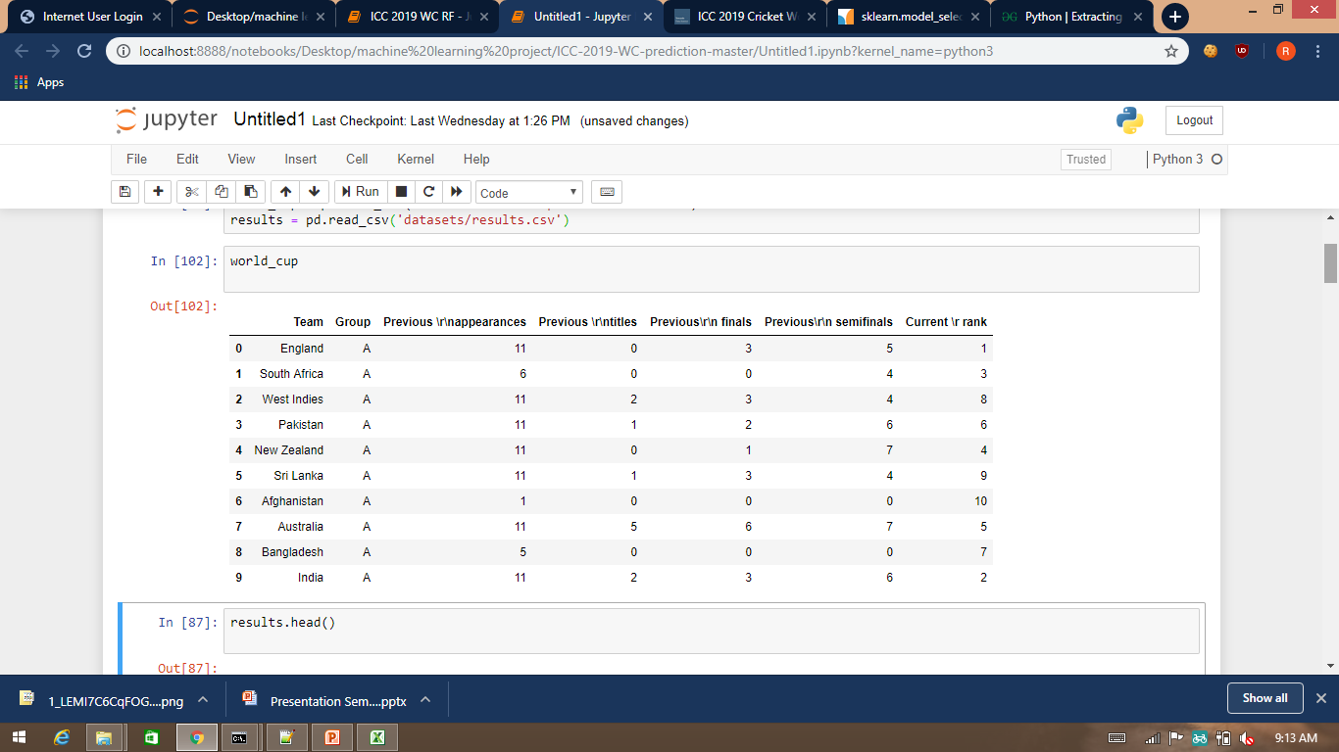
Dataset-2

Slide 6
Feature Engineering
Feature engineering is the process of transforming raw data into features that better represent the underlying problem to the predictive models, resulting in improved model accuracy on unseen data.
I prepared a model by selecting all the features and I got an accuracy of around 55% which is not pretty good for a predictive model and after doing some feature selection and feature engineering without doing any logical changes in my model my accuracy jumped to 71% which is quite impressive.

Slide 7
BRIEF ON SYSTEM
Random Forest Algorithm
The random forest combines hundreds or thousands of decision trees, trains each one on a slightly different set of the observations, splitting nodes in each tree considering a limited number of the features. The final predictions of the random forest are made by averaging the predictions of each individual tree.

Slide 8
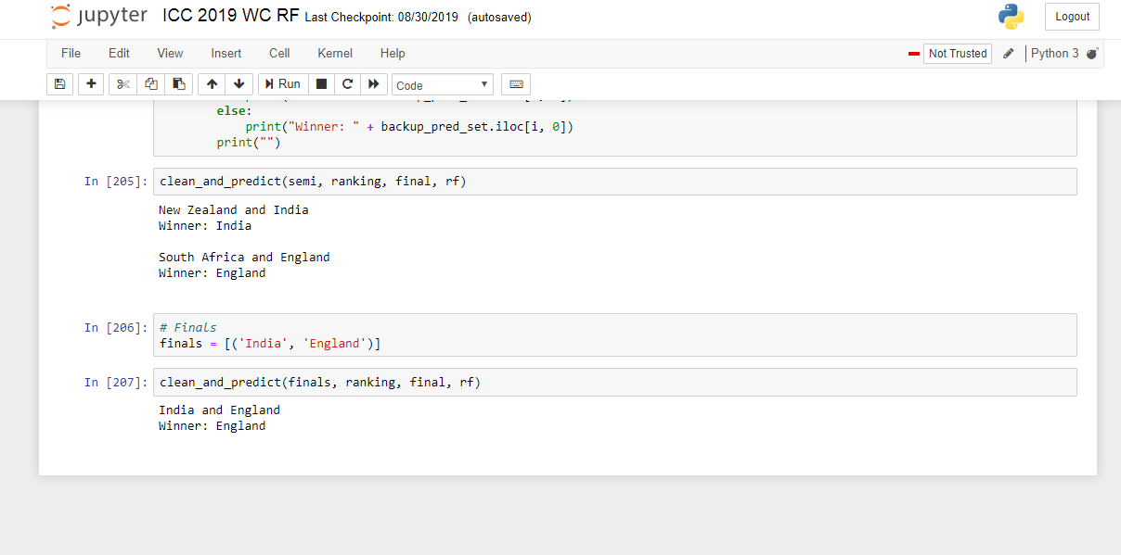
OUTPUT

Slide 9
THANK YOU

